Slide 1
Welcome to ROFA’s ‘Uniting our voices & defending our rights’ conference 2016

Slide 2
A year on….
Sharing and learning from our campaigning over the last year
Exploring and debating how we can defend and progress our vision of rights, inclusion and equality
Discussing and mapping out our campaign priorities over the next year
Building our alliance

Slide 3
To help us do this we have…
A keynote speech by Professor Peter Beresford and a panel discussion with ROFA members
Workshops sharing info and top tips on some great examples of campaigning you have done over the last year
Plus plenty of time for discussion and debate on priority issues for the next year

Slide 4
A whistle stop tour of campaigning highlights…

Slide 5
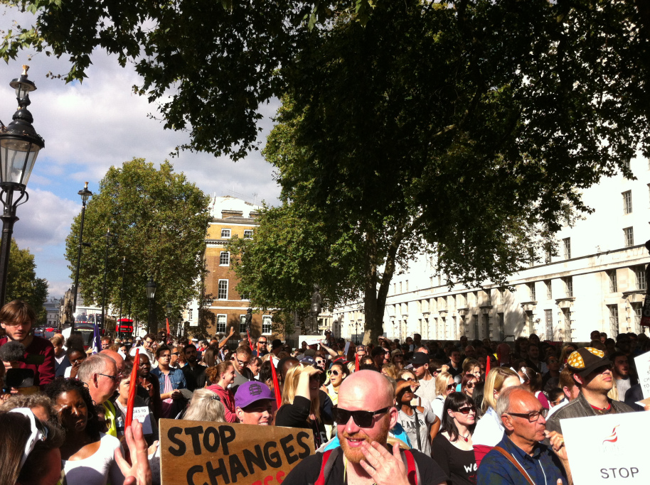
Stop Changes 2 ATW march
Notes:
Employment: 1000 Deaf and Disabled people and BSL interpreters marching through London in September 2015 to protest against cuts to Access to Work – petition of over 20,000 signatures handed in at Downing Street (see attached for a couple of pics).
In November’s Autumn Statement George Osborne announced a real terms increase in funding for Access to Work. [NB obviously problems remain….]

Slide 6
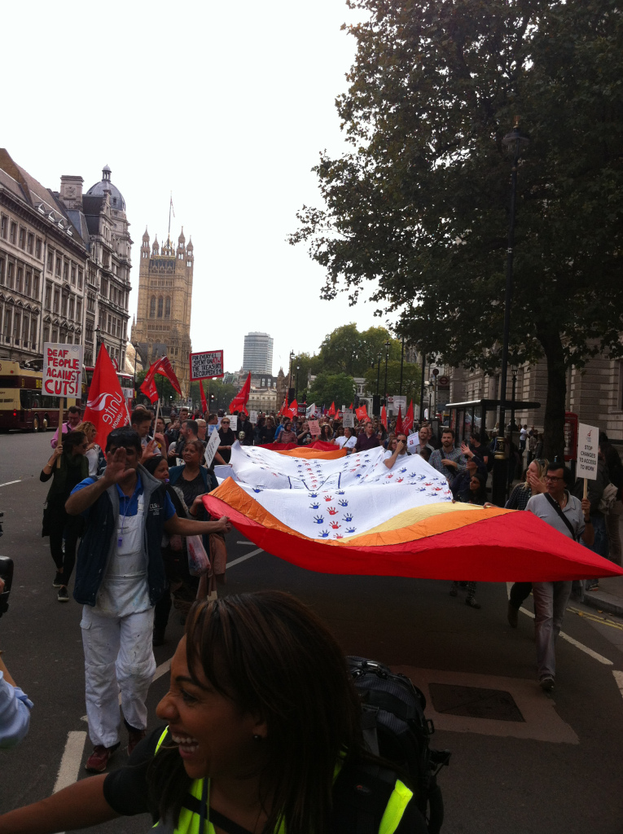
Stop Changes 2 ATW march

Slide 7
Notes:
Independent living:
Maintained momentum, pressure and profile of ILF / independent living = Former ILF Recipient grant announced by government for next four years !
Title very interesting – the govt wanted to bury ILF now they are taking great pains to name check it!!

Slide 8
ESA cut protest
Notes:
Welfare reform: increased public awareness about the negative impact of welfare reform on Disabled people and couple of significant gov u-turns - that suggest they are going to have real problems implementing the 12 billion welfare cuts they promised in their manifesto
U-turn on changes to working tax credits which would have made Disabled people on WTC significantly worse off (The gov publicly said the changes would not affect Disabled people but Disabled campaigners exposed how this was not true and contributed to the Lords rebellion which forced the u-turn)
ESA WRAG cut went through but Labour followed Lords in voting against it and name and shame campaign of those MPs who voted for it resulted in some high profile “sackings” of disability charity patrons. This was particularly embarrassing for Zac Goldsmith in his mayoral election campaign. Also contributed to the climate which led to…
High profile gov u-turn on PIP cut. This episode involved IDS resigning as Secretary of State for Work and Pensions claiming that gov cuts were ‘unjust’ and indefensible’ targeting the poor and most vulnerable in society.

Slide 9
Protest in Parliament during week of PIP u-turn – calling on Osborne to apologise
Notes:
Latest : damning report by UN Committee on Economic, Social and Cultural rights expressed serious concerns at the impact of austerity measures on certain groups of people including Disabled people

Slide 10
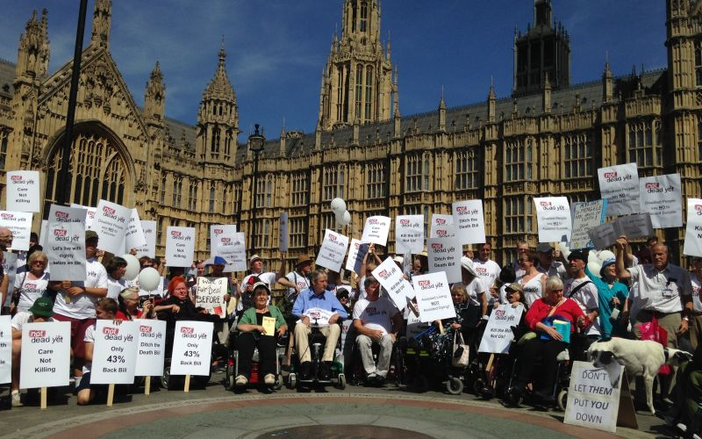
Not Dead Yet protest against Marris’ bill
Notes:
Assisted suicide – in September 2015 Marris’ bill to legalise assisted suicide was soundly defeated in the House of Commons and will not be back there this Parliament.
Then earlier this year Disabled campaigners attracted media interest in our international opposition to the Hollywood film Me before You, drawing attention to the negative messaging about the value of Disabled people’s lives.

Slide 11
DHC Matters launch
Notes:
Disability Hate Crime.
In London DDPOs have been working with the MET to develop a - Disability Hate crime matters initiative which has set up a new way of recording hate crime against disabled people.
Pic of the launch which say 80 res from DDPOs and the Met and CPS launch the initiative - which has recorded incidents of DHC increase by 500%.

Slide 12
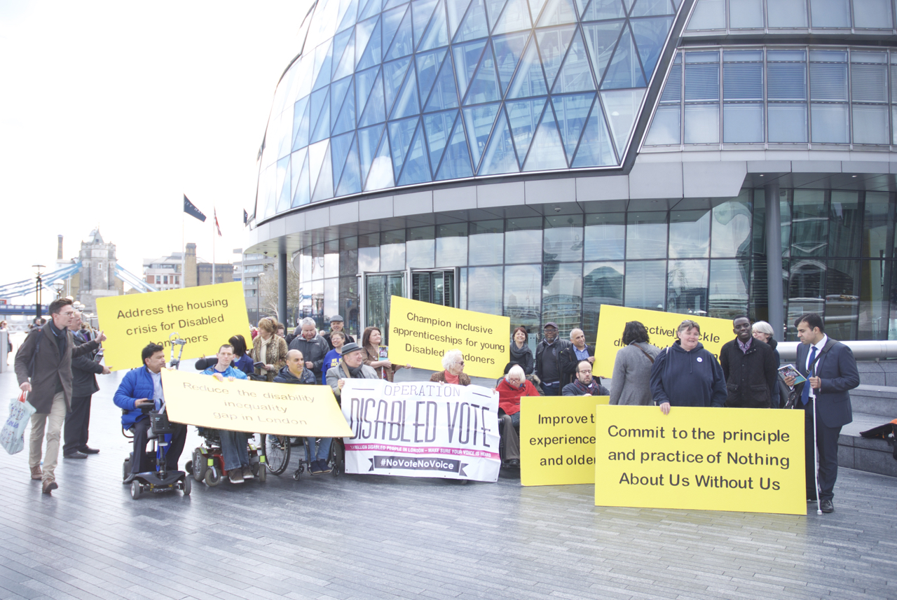
London Mayoral election …
Notes:
Launch of “Disabled Peoples Challenge to the next Mayor of London” - meetings with all 4 Mayoral candidates
We are going to be looking at how we progress and build on a lot of these issues in the workshops and after lunch discussions…

Slide 13
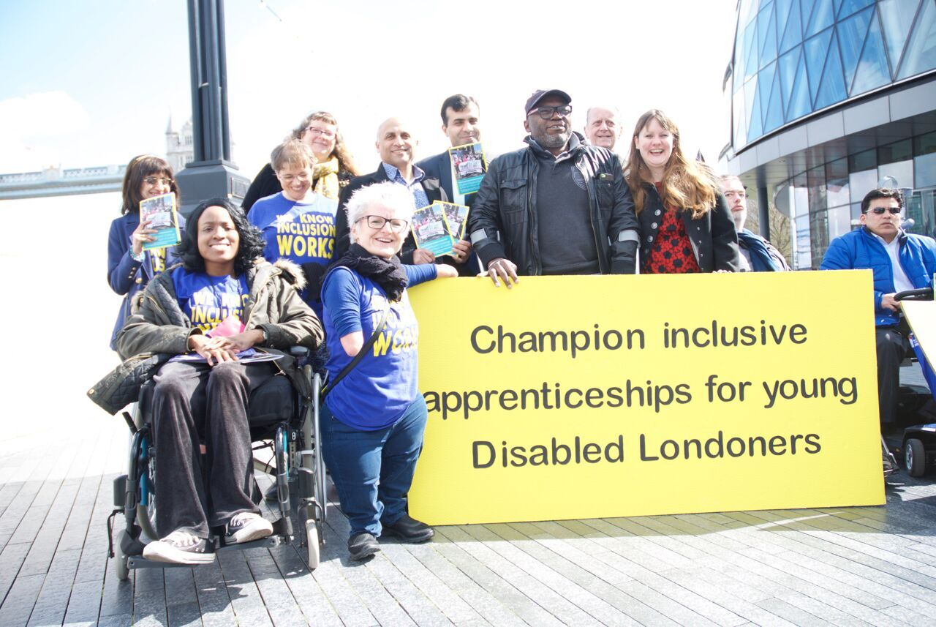
Inclusive education
Notes:
Delayed Government’s Disabled Students Allowance reforms by a year as a result of supporting disabled students with taking legal action against the flawed Government’s DSA consultation process.
Successfully supported a disabled parent who is a wheelchair user to challenge the Local Authority’s refusal to allocate a wheelchair accessible school for his son at an Independent Admissions Appeals Panel.. The LA refused to comply with their Equality Act 2010 duties in terms of having an admissions policy that included a process for the LA to consider reasonable adjustments for disabled parents so that they can take their children to school etc. We are hoping that disabled parents will be explicitly included into the Government’s Schools Admissions Code (under review) which all LAs and publically funded Schools must comply with after meetings between ALLFE and DFE
Setting the Agenda: ALLFIE’s briefings / lobbying on the Enterprise Bill resulted in Government’s Apprenticeships for people with LDs task force and recommendations including changes to the standard policy requiring all apprentices to gain Maths and English GCSEs or functional skills qualifications.

Slide 14
Defending our vision of rights, inclusion and equality…
In a neo liberal Brexit Britain….with a new Tory government……

Slide 15
Campaign priorities in 2016/17…
Last year we agreed following campaign priorities:
• Benefits and welfare reform
• Independent Living
• Disability hate crime
• Employment
• Equality and education

Slide 16
What next: Benefits and welfare reform?
EHRC cumulative impact assessment
Scrap ESA/WRAG
PIP / AA
Challenge biopsychosocial model
Campaign against ATOS, Capita and Maximus
UNCRPD : UK scrutiny in 2017
Develop our vision of community / welfare support that delivers choice & control
Notes:
Long term goals:
All disabled people have a right to inclusive welfare support and housing that enables independent living, inclusion and participation in the community as defined in the UNCRPD
Scrap the Bedroom Tax, Work Capability Assessments, Benefit Sanctions, PIP and restore DLA
Remove the disabling barriers in the employment market so disabled people can access education, training and jobs
2015-16 goals:
To get alternative welfare strategies into the political programmes of other Parties
A cumulative equality impact assessment on the impact of welfare reform on disabled people
Increase media profile & research on deaths related to ESA
Campaign against ATOS and Maximus

Slide 17
What next: Independent Living ?
LA/Social care funding crisis
Impact of social care funding cuts
DP and living wage
Monitor Care Act / take legal action
Develop our vision of independent living: PB is not enough we need DPO led /peer community infrastructure as well
Notes:
Long term goals:
Right to independent living for disabled people
Article 19 enshrined in domestic legislation
Adequate social care / independent living funding
National body independent of LAs responsible for administering social care support co-produced with Disabled People
2015-16
ILF replacement monies secured to LAs post April 2016
Direct Payments rates in line with the living wage
Case law that establishes well-being and independent living in Care Act 2014 as over-ruling considerations of available resource and maximum expenditure policies
Media & public profile of ILF & independent living issues maintained
Increase understanding of widest definition of independent living as described in 12 pillars of independent living

Slide 18
What next: Disability hate crime?
Roll out DHC Matters
Increase DPO capacity to tackle DHC and lobby
Raise awareness of hate crime
Notes:
Long term goals:
• To achieve equality of legislation for disability hate crime (so that it is treated the same by law as hate crime against other protected characteristic qualities strands)
• To improve disability hate crime reporting so that levels of estimated incidents of DHC (approximately 62,000 per year ) are matched by same number of reported incidents of DHC.
• To increase numbers of successful prosecutions of DHC
• To empower Disabled people so we no longer expect or put up with DHC
• To have a range of dedicated DDPO community and policing resources and support to improve awareness and reporting of Disability Hate Crime.
2015-16 goals:
Increase levels of Deaf and Disabled people and their organisations representation at strategic level in Criminal Justice policy and decision making
Improve DHC reporting making it easier, more accessible and a more positive experience for Deaf and Disabled people
Raise awareness of disability hate crime in our communities
Improve understanding of disability hate crime and appropriate ways to address it among the police
Disabled People's Organisations to have more opportunities for fully funded roles tackling disability hate crime, e.g as third party reporting centres, advocacy, or training the police and other statutory agencies

Slide 19
What next: Employment?
ATW – maintain pressure, evidence and scrutiny
Employment Green paper …
Brexit affect on workers & anti discrimination rights
Develop evidence of positive employment support models
Notes:
Long term goals:
• Equal access to employment and career development for Deaf and Disabled people
• Provision of a range of high quality, personalised support to disabled people to get and stay in work.
• Inclusive and accessible employer and working practices that enable Disabled people to get and stay in work.
• Meaningful redress under the law for discrimination at work
2015-16 goals:
Reverse negative changes to Access To Work (ATW)
Improve quality of ATW and increase awareness of ATW amongst Disabled people and employers
Increase understanding of the failings of current Work programme and work choice models and lobby for different employment support models in lead up to new Work programme and work choice contracts in 2017
Challenge employment discrimination

Slide 20
What next: Equality in education?
Campaign for inclusive apprenticeships
Campaign for access to mainstream education provision
Academies?
Notes:
Long term goals:
• All disabled learners have the legal and human right to attend mainstream courses in mainstream education settings.
• All disabled learners have the legal right to support to enable participation and learning.
• Education buildings to be made accessible to all disabled learners.
• All mainstream course curricula are accessible to and inclusive of disabled learners.
• All education assessments and accreditations are inclusive.
• Inclusive education focused training is compulsory for all education professionals and staff.
2015-16 goals:
Analysis of SEN Tribunal Case law highlights the bias towards segregated education and the lack of pupil/student/family choice
Recognition that current SEND policy and law acts as a disincentive for education providers
Education funding analysis
Children & Families Act 2014 implementation review and case studies
Analysis of Higher Education Statistics that highlight the impact of DSA reforms on disabled students and case studies.

